Slide 1
Ramadan Revealed: A Community-Based Perspective on Ramadan

Slide 2
Contributors
Aneri Shah, BA/MD Scholar, College of Liberal Arts-Twin Cities
Nandini Avula, BA/MD Scholar, College of Liberal Arts-Twin Cities
Warda Hussein, Pre-Nursing Student, College of Liberal Arts-Twin Cities
Christina Cipolle, PharmD, Director of Interprofessional Education & Quality, College of Pharmacy-Twin Cities
Chloe Goodman, Center for Health Interprofessional Programs-Twin Cities

Slide 3
Disclosure Statement
BD Helping Building Healthy Communities Award supported our work.
We appreciate the opportunity to be a part of their vision of expanding access and improving care for underserved populations in the U.S.

Slide 4
Thank You to Our Partners
University of Minnesota, Twin Cities
Community-University Health Care Center
Center for Health Interprofessional Programs
Walter Library: Media Services
Becton, Dickinson and Company (BD) Education Center
Direct Relief, Non-profit Organization
National Association of Community Health Centers

Slide 5
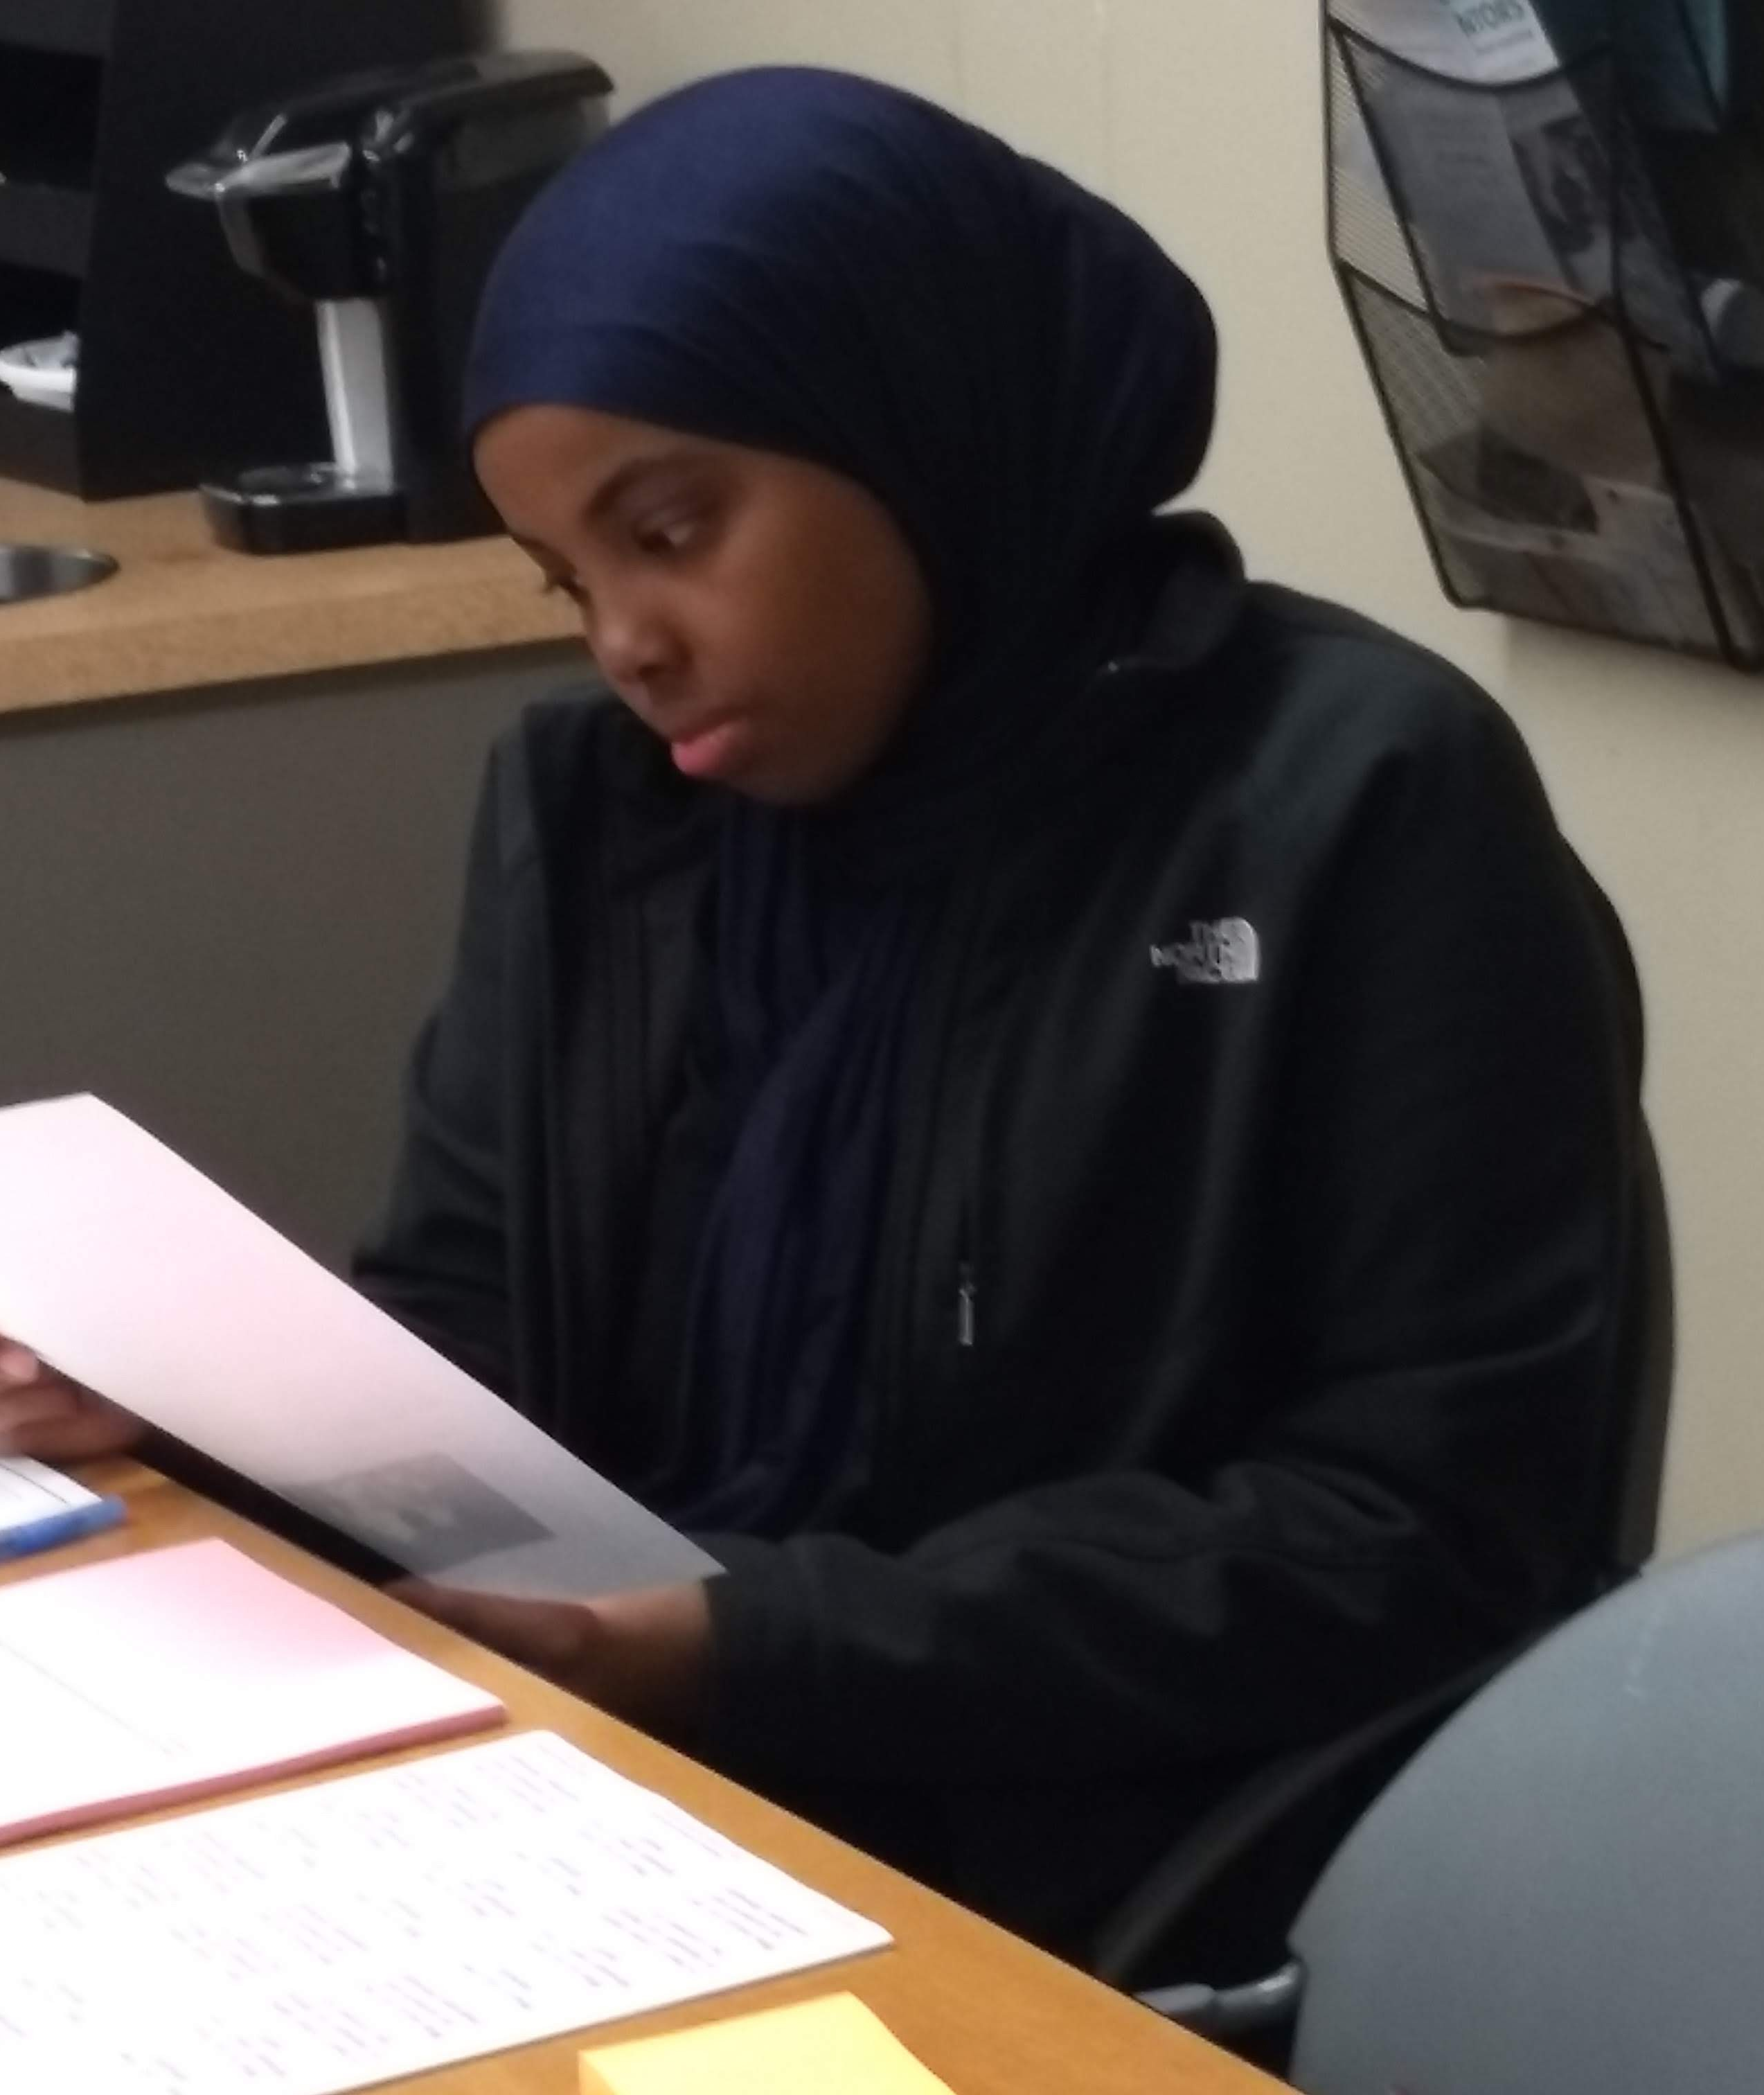
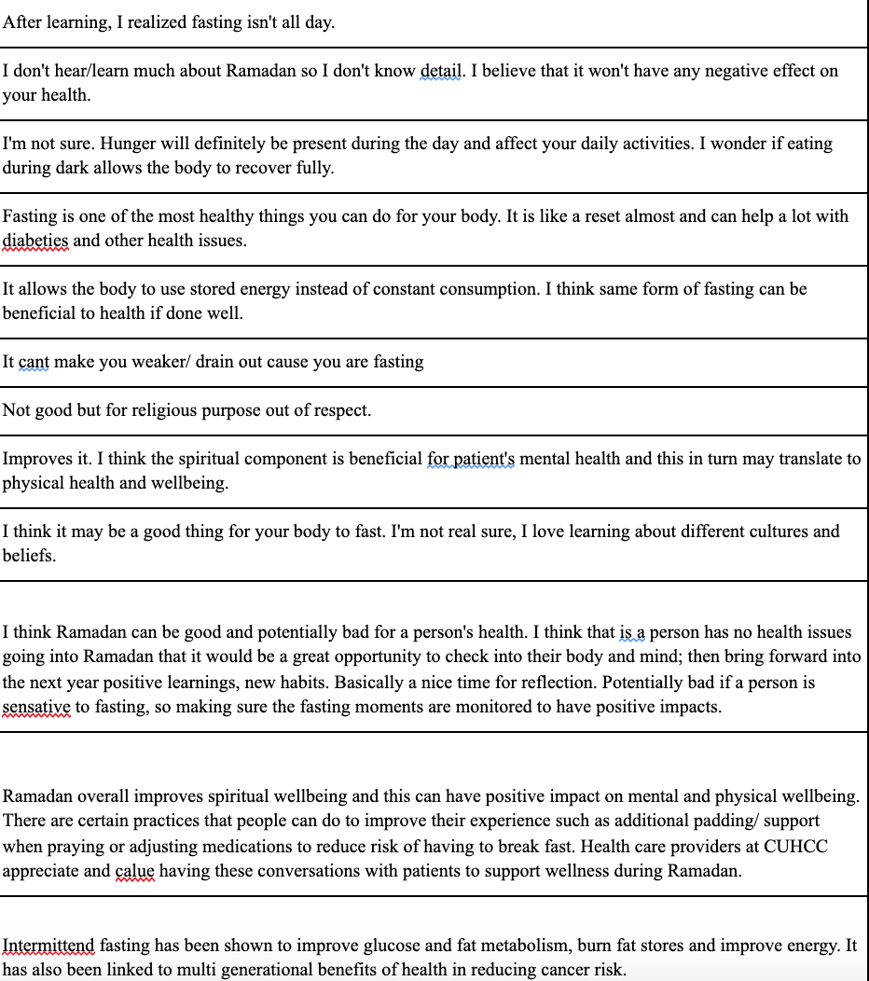
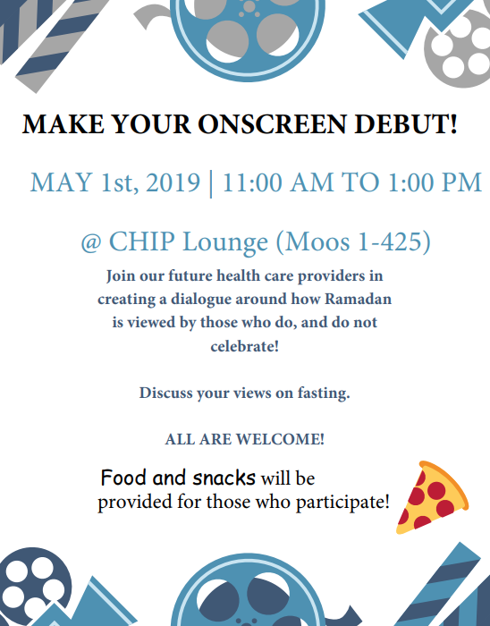
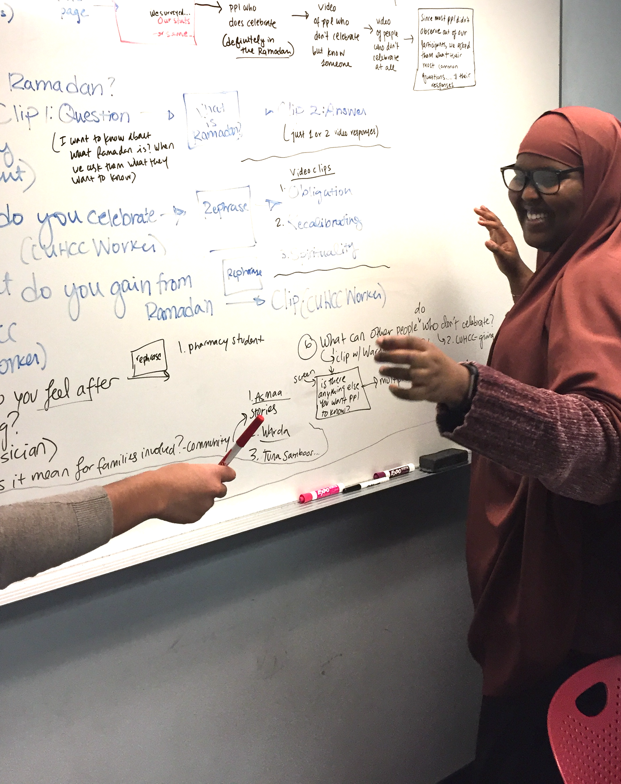
Methods
Planning
Surveying
Filming
Used a feedback and community-based approach
Our surveys influenced the questions asked to interviewees. By engaging with more individuals, common themes were identified that influenced subsequent interviews
It was a parallel process where surveys and interviews were conducted simultaneously
Showing
Editing
Storyboarding

Slide 6
Learning Objectives
Identify the main aspects of Ramadan
Describe common misconceptions surrounding Ramadan
Understand the importance of Ramadan to those who observe and their families
Approach Ramadan from an Islamic perspective and apply it to practice

Slide 7
What is Ramadan?
1

Slide 8
Background: What is Ramadan?
9th month of the lunar calendar, exact start date varies each year depending on sighting of the new crescent moon
During the day, Muslims who can fast abstain from food and drink
Time of family reunion and connectedness
Families engage in night prayers in the mosque
Giving to charity is encouraged during this time
Different cultures have different traditions, but generosity and worship is centered on throughout the holy month
https://www.aljazeera.com/indepth/features/ramadan-2019-important-muslims-190505145156499.html#:~:text=Healthy%20adult%20Muslims%20fast%20in,encouraged%20during%20the%20holy%20month.

Slide 9
Background: Ramadan and Islam
5 pillars of Islam: Core beliefs and duties for all Muslims
Profession of faith, Prayer, Alms, Fasting during Ramadan, Pilgrimage
By abstaining from certain distractions and negativities, Muslims seek richer perception of God (Allah)
Renew awareness and gratitude for God’s grace upon them
Form deeper understanding of the Qur’an (holy book) which was first revealed during this month
It serves as a reminder of their religious duty to help those in need
https://www.metmuseum.org/learn/educators/curriculum-resources/art-of-the-islamic-world/unit-one/the-five-pillars-of-islam https://www.saudiembassy.net/five-pillars-islam

Slide 10
Regional Distribution of Muslims
https://www.pewresearch.org/fact-tank/2017/01/31/worlds-muslim-population-more-widespread-than-you-might-think/

Slide 11
Important Terms
Suhoor
Iftar
Eid al-Fitr
Din
The morning meal eaten by Muslims before sunrise
The evening meal eaten by Muslims after sunset during Ramadan.
Eid means “festival” or “feast” in Arabic. This celebration marks the end of Ramadan. People greet each other with “Eid Mubarak,” meaning “Blessed Eid.” Food is prepared & gifts are distributed to those in need and family. Forgiveness is encouraged.
One’s religion or religious duty to God, themselves, and their traditions.

Slide 12
Monthly Overview of Ramadan
Ramadan begins with the sighting of the new moon in countries that are able to see it. Typically the first day is one of the more difficult ones since it takes time to adjust to fasting
The last 10 days of Ramadan are some of the more sacred days of the month. It is said that the Night of Decree falls on one of the last ten days of the month and on that day the Quran was revealed. Usually during this time people increase additional prayers
After the first two weeks, people are typically more adjusted to fasting and it is much easier to fast. Most people have adapted to a schedule of reading more Quran, listening to lectures or just spending more time with family.
Eid al-Fitr! After Ramadan ends and the new moon is sighted signalling the new month, the Eid festival begins which is three days of celebration and fun for Muslims

Slide 13
A Day in Ramadan
Suhoor: The predawn meal that Muslims eat before the morning prayer before they begin their fast
Days usually vary for everyone, but many spend more time reading more religious scripts, like the Quran, listening or attending lectures, and spending more time with family
Most people don’t experience any drastic changes in their usual schedule. Many will still go to work or school, etc. One change is that some people will try to make it to the mosque for the 5 daily prayers if they can.
Iftar: The meal where Muslims break their fast. Typically this meal is at sunset after the dusk prayer.

Slide 14
What meal is eaten immediately before sunrise during Ramadan?
A) Iftar
B) Suhoor
C) Din
D) Eid
1

Slide 15
What meal is eaten immediately before sunrise during Ramadan?
A) Iftar
B) Suhoor
C) Din
D) Eid
Explanation: Suhoor is the Islamic term for the meal consumed early in the morning before fasting. It allows people to fill themselves adequately in order to fast throughout the day. This differs from Iftar which is the meal eaten after sunset; usually, the fast is broken by eating dates and drinking water.
1

Slide 16
What are some of the common misconceptions surrounding Ramadan?
2

Slide 17
“In the workplace, they are confused and dumbfounded on why I'm doing it. They say some things that are offensive without knowing, like "not even water? Haha" or "that's insane." It's annoying.”

Slide 18
“I have had managers who don't understand the purpose, so I would have to explain the purpose and explain why we participate in Ramadan for 30 days every year.

Slide 19
Common Misconceptions
Myth
Reality
Muslims fast even when they are sick
Ramadan means Muslims are only fasting from food and drink
There is no reason someone would voluntarily fast for a whole day
Not all Muslims are fasting during Ramadan
Ramadan is more than just fasting from food and water
Ramadan carries great spiritual importance

Slide 20
1. Not all Muslims are fasting during Ramadan
If a Muslim is not fasting, it does not necessarily mean they do not want to.
2. Ramadan is more than just fasting from food and water
Ramadan also involves fasting from negative thoughts and actions including sexual activities and cursing
3. Ramadan carries great spiritual importance
Although understanding poverty may be part of the reason people fast, fasting was ordained on Muslims to help them achieve greater “Taqwa” or God-consciousness.
Most scholars agree that elderly, pregnant, nursing or menstruating, people, ill people, and travelers are exempted from fasting
By avoiding basic necessities, Muslims are able to concentrate on worship and gratitude.

Slide 21
Those who observe Ramadan may fast from the following:
A) Food
B) Negative Thoughts
C) Foul Language
D) All of the above
3

Slide 22
Those who observe Ramadan may fast from the following:
A) Food
B) Negative Thoughts
C) Foul Language
D) All of the above
Explanation: In the video, it was mentioned that during Ramadan, “…you’re not just fasting from food. You’re supposed to be fasting from foul language, fasting from hurting others, fasting from any negative thing…”
3

Slide 23
What do those who observe gain from Ramadan?
3

Slide 24
Every year I look forward to Ramadan. Spiritually, it helps connect me to God. I pray 5 times everyday, read the Quran daily, and overall make myself a better person during this holy month. Ramadan isn't only about refraining from food and drink. It is much more. It is being God aware in all aspects of life!

Slide 25
3
Spiritual Growth. By praying more, reading the Quran more, and minimizing negative thinking, Ramadan encourages consciousness and worship of Allah (taqwa).
Community Development. When Muslims fast as a community during Ramadan, it allows people to get closer to one another and closer to God together.
2
1
Individual Improvement. During Ramadan, Muslims work on improving themselves by praying, reading, and donating more. Fasting teaches control, sympathy, empathy and sincerity.

Slide 26
“One of the reasons Muslims fast is to humble ourselves especially around issues of hunger and food insecurities. That is why there is a lot of food donated during this month and donating is one of the 5 pillars of Islam. I also gain spirituality because it shows my devotion to God when I am avoiding food and water and especially more when it is summertime.”

Slide 27
Ramadan’s Impact on Mental Health
Religious practices such as fasting during Ramadan have been shown to alleviate stress, anxiety, and depression levels in Iranian Nurses ¹
Fasting and practicing mindfulness during fasting has helped some people transform their mental health and appreciate life around them²
Koushali, Ali Noruzi et al. “Effect of Ramadan fasting on emotional reactions in nurses.” Iranian journal of nursing and midwifery research vol. 18,3 (2013): 232-6.
https://www.insider.com/how-ramadan-transformed-my-mental-health-islam-muslim-anxiety-depression-2020-5

Slide 28
“As a person who celebrates Ramadan each year, [Ramadan] is time for renewal and cleanse of our body, mind, spirits.”

Slide 29
“I gain self-control and inner peace”

Slide 30
Ramadan can lead to ___
A) Individual Improvement
B) Spiritual Growth
C) Community Connection
D) All of the above
3

Slide 31
Ramadan can lead to ___
A) Individual Improvement
B) Spiritual Growth
C) Community Connection
D) All of the above
Explanation: As many mentioned in the video module, Ramadan is about improving yourself, building relationships, and getting closer to God.
3

Slide 32
How can healthcare team members work with patients during Ramadan?
4

Slide 33
I once had a doctor try to make me do a quick blood test. But I was saying I couldn't because I didn't want to break my fast. The doctor didn't understand why I wasn't going to be eating.

Slide 34
Fasting and Health: An Islamic Perspective
“Oh you who believe! Fasting is prescribed to you as it was prescribed to those before you that you may learn piety and righteousness.”
-Quran [2:183]
Fasting for Muslims is an act of morality and conventional reverence
Perseverance and self control allows for constant spiritual growth
The Quran “prescribes” and states that fasting is essential for spiritual health
http://www.hizb.org.uk/islamic-culture/ayat-reflection-fasting-has-been-prescribed-for-you-%D9%83%D9%8F%D8%AA%D9%90%D8%A8%D9%8E-%D8%B9%D9%8E%D9%84%D9%8E%D9%8A%D9%92%D9%83%D9%8F%D9%85%D9%8F-%D8%A7%D9%84%D8%B5%D9%90%D9%91/

Slide 35
A Healthcare Team Member’s Role
Listening
Understanding
Asking Questions

Slide 36
It is important for providers to listen to their patients during Ramadan.
TRUE OR FALSE?
4

Slide 37
It is important for providers to listen to their patients during Ramadan.
TRUE OR FALSE?
Explanation: The first step to understanding is just by listening.
4

